Slide 1



Potato Leaf Disease Detection
Deep Rohit (21DCS105)
Asst. Prof. Mohini Darji
Dr. Jatin Patel
2nd World Conference On
Information Systems for Business Management
ISBM 2023

Slide 2
Outline
INTRODUCTION
LITERATURE SURVEY
METHODOLOGY
RESULT AND OUTCOMES
CONCLUSION
REFERENCES

Slide 3
INTRODUCTION
The agricultural significance of nations like India, where economies are closely tied to farming, underscores the importance of nurturing crops from their early stages to harvest. A substantial portion of India's population, particularly those in rural areas, depends on agriculture for their livelihoods.
Amidst the challenges faced by the agricultural sector, such as food security and nutrition concerns, the potato emerges as a vital crop due to its nutritional richness. However, the prevalence of potato infections, notably early and late blight, threatens crop health. To address these challenges, a novel approach employing Convolutional Neural Networks (CNN) for image classification is proposed.

Slide 4
Continue…
This method aids in distinguishing between healthy, early blight, and late blight leaves, empowering farmers to promptly identify and manage plant diseases.
The research contributes by introducing innovative leaf extraction techniques, designing an optimal CNN model, and assembling a dataset encompassing various potato leaf infections.
Structured across several sections, the paper delves into the necessity of leveraging image processing and machine learning for plant disease identification, reviews prior research, outlines detection strategies, assesses potential impacts, and emphasizes the framework's foundational role in advancing plant disease research.

Slide 5
LITERATURE SURVEY
TITLE | AUTHOR | DESCRIPTION
Severity identification of Potato Late Blight disease from crop images captured under uncontrolled environment | S. Biswas, B. Jagyasi, B. P. Singh and M. Lal | This paper enhances the use of Fluffy C-mean Clustering for potato late blight detection with an accuracy of 93% over 27 images dataset.
Detection of Potato Disease Using Image Segmentation and Machine Learning | M. A. Iqbal and K. H. Talukder | This paper enhances the uses of Random Forest Classifiers for Early and Late Blight Detection with an accuracy of 97% over 450 images dataset.
Detection of potato diseases using image segmentation and multiclass support vector machine | M. Islam, A. Dinh, K. Wahid, and P. Bhowmik | This paper enhances the use of the Support vector machine model with an accuracy of 95% over 300 images dataset.
A survey on detection and classification of rice plant diseases | J. P. Shah, H. B. Prajapati, and V. K. Dabhi | This is a survey paper where 19 papers were taken into consideration covering the detection of rice plant disease.

Slide 6
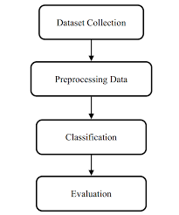
Methodology
Proposed Framework

Slide 7
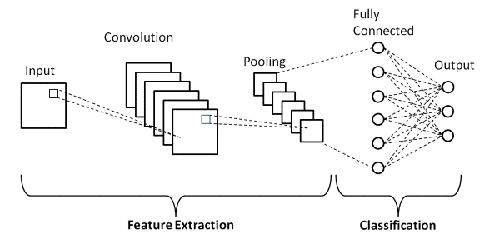
Data Collection Data Preprocessing
Image Classification
Classes | No of Images
Early Blight | 1000
Healthy Leaf | 152
Late Blight | 1000
Total | 2152
Dataset | 80:20
 | Train | Test
Early Blight | 800 | 200
Healthy Leaf | 120 | 32
Late Blight | 800 | 200
Total | 1720 | 432

Slide 8
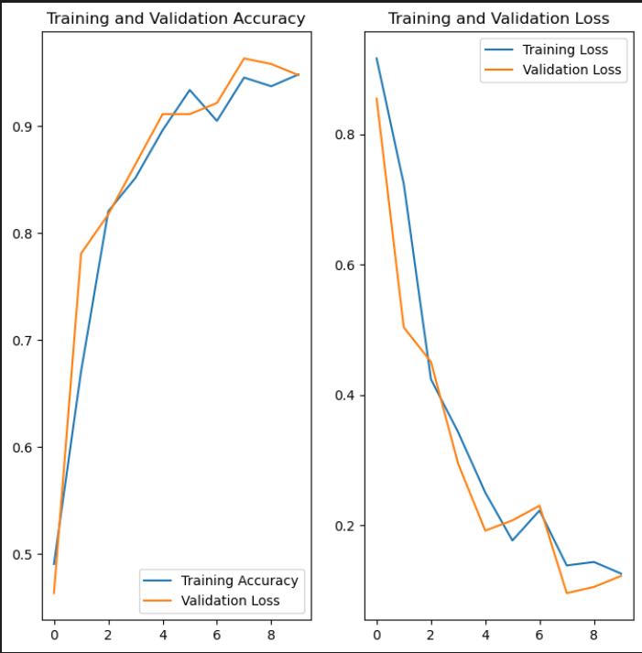
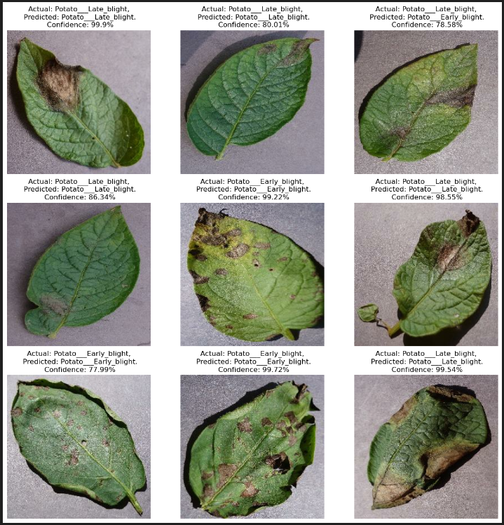
Results and Discussion

Slide 9
Conclusion
In Conclusion, To identify late blight, early blight, and healthy leaf pictures in potato plants, this study suggests a classification-based strategy employing deep learning techniques, notably convolutional neural networks (CNN). With an impressive accuracy of 99.01%, the researchers discovered that CNN is the best approach for this kind of categorization. The agricultural industry, especially in India where many farmers lack literacy and understanding of plant diseases, greatly benefits from the work being done on this initiative. By increasing disease knowledge and control, this effort might have a large positive impact on potato producers.

Slide 10
References
S. Biswas, B. Jagyasi, B. P. Singh and M. Lal, "Severity identification of Potato Late Blight disease from crop images captured under uncontrolled environment," 2014 IEEE Canada International Humanitarian Technology Conference - (IHTC), Montreal, QC, Canada, 2014,
M. I. Tarik, S. Akter, A. A. Mamun and A. Sattar, "Potato Disease Detection Using Machine Learning," 2021 Third International Conference on Intelligent Communication Technologies and Virtual Mobile Networks (ICICV), Tirunelveli, India, 2021, pp.800-803,doi:10.1109/ICICV50876. 2021.9388606.
M. Islam, A. Dinh, K. Wahid, and P. Bhowmik, Detection of potato diseases using image segmentation and multiclass support vector machine 2017, Can. Conf. Electr. Comput. Eng., 8–11.
S. R. Maniyath et al., Plant disease detection using machine learning 2018, Proc. 2018 Int. Conf. Des. Innov. 3Cs Comput. Commun. Control., 41–5.
J. P. Shah, H. B. Prajapati, and V. K. Dabhi, A survey on detection and classification of rice plant diseases 2016, 2016 IEEE Int. Conf. Curr. Trends Adv. Comput.
Suresh V, Gopinath D, Hemavarthini M, Jayanthan K, and Mohana Krishnan, Plant dis-ease using image processing 2020, IJERT, 9, 78-82

Slide 11


